Slide 1
Data Analysis Project 1. Predict stroke
SUPERVISED BY:
MR. RANJAN KUMAR
SUBMITTED BY:
RAVI SHANKAR
BATCH:5132

Slide 2
Problem Statement
Healthcare-dataset-stroke-data.csv dataset is used to predict whether a patient is likely to get stroke based on the input parameters like gender, age, and various diseases and smoking status. A subset of the original train data is taken using the filtering method for Machine Learning and Data Visualization purposes.

Slide 3
About The Data
According to the World Health Organization (WHO) stroke is the 2nd leading cause of death globally, responsible for approximately 11% of total deaths. This dataset is used to predict whether a patient is likely to get stroke based on the input parameters like gender, age, various diseases, and smoking status. Each row in the data provides relavant information about the patient.
Attribute Information
1) id: unique identifier 2) gender: "Male", "Female" 3) age: age of the patient 4) hypertension: 0 if the patient doesn't have hypertension, 1 if the patient has hypertension 5) heart_disease: 0 if the patient doesn't have any heart diseases, 1 if the patient has a heart disease 6) ever_married: "No" or "Yes" 7) work_type: "children", "Govt_jov", "Never_worked", "Private" or "Self-employed" 8) Residence_type: "Rural" or "Urban" 9) avg_glucose_level: average glucose level in blood 10) bmi: body mass index 11) smoking_status: "formerly smoked", "never smoked", "smokes" or "Unknown"* 12) stroke: 1 if the patient had a stroke or 0 if not *Note: "Unknown" in smoking_status means that the information is unavailable for this patient

Slide 4
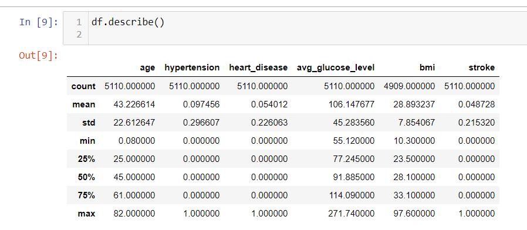
Data Describe

Slide 5
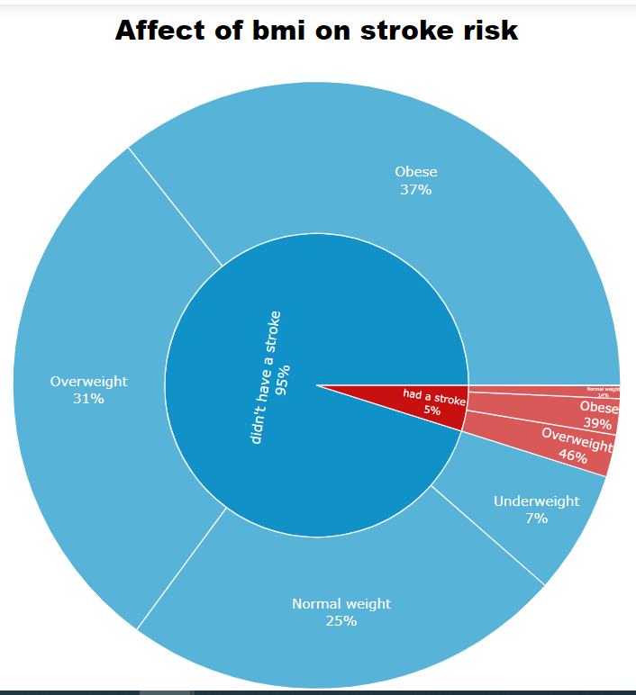
Affect of BMI on Stroke From this Graph or data, We can easily conclude that if a person getting stroke then 46% person is overweight and 39% is obese.

Slide 6
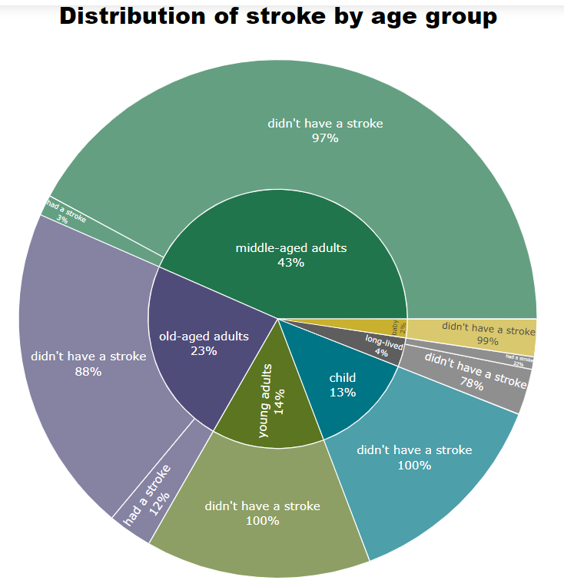
Affect of Age on stroke There is a large correlation between age and stroke risk. Almost all doctors know that stroke is most often an age problem. However, this can also happen with young people, in the available data in groups "baby" and "child", 2 people had a stroke. The risk of stroke mainly affect the people whose age is more than 55 or 60. In the pie graph we can see the whose is in the group of old age has 12% risk and who is long lived aged more than 80 there is 22% risk increase.

Slide 7
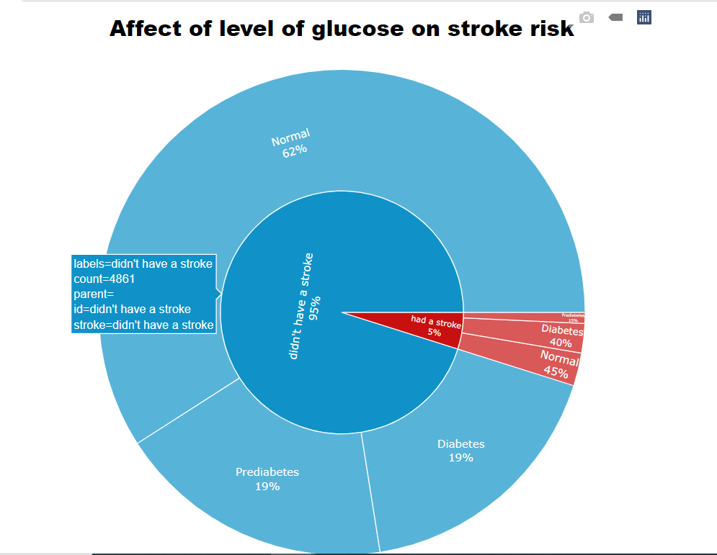
Diabetes has a big impact on the risk of stroke Diabetes has a big impact on the risk of stroke. if the glucose level is very high then chances of getting stroke is very high .

Slide 8
Impute missing value
In Bmi column has 201 entries has missing values.
Solution: To impute missing values we mean of bmi data and fill all the data. Because it is continuous data.
In smoking status column: there are 1544 entries are unknown.
Solution:- To impute these missing values we use mode function.
because It is categorical data.

Slide 9
Approch To Solve Problem
Algorithm:-
Random Forest Classifier
Classification Technique
Confusion matrix

Slide 10
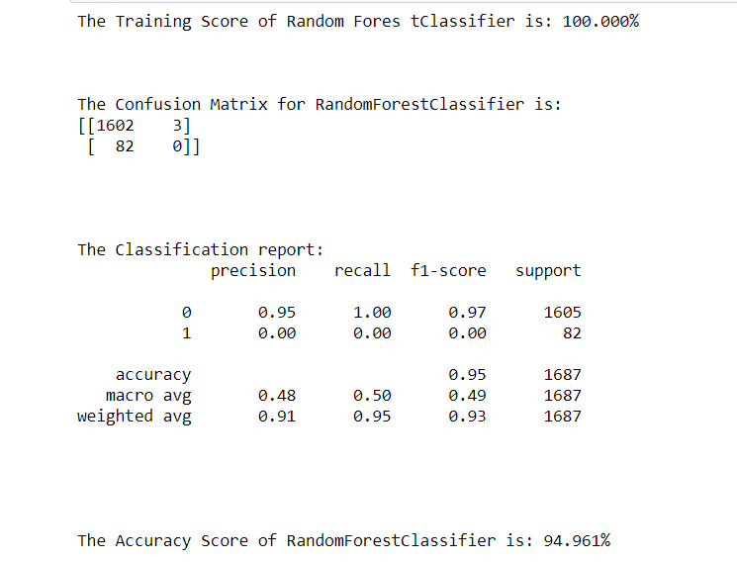
Solution: Random Forest classifier have high precision. The number of false-positive is better handled by Random Forest. The accuracy of confusion matrix is 94.96%. Therefore we can use Random Forest to predict Patient will suffer from a stroke or not.

Slide 11
Conclusion
We use the dataset, where we analyse the data or visualize the the affecting factor of stroke such as Age, Glucose level, Smoking status
Heart Disease, BMI, Hypertension.
We model the data to use Machine learning Algorithm
To find the accuracy of Prediction by Random Forest Classifier
The Accuracy is 94.96%.

